Slide 1
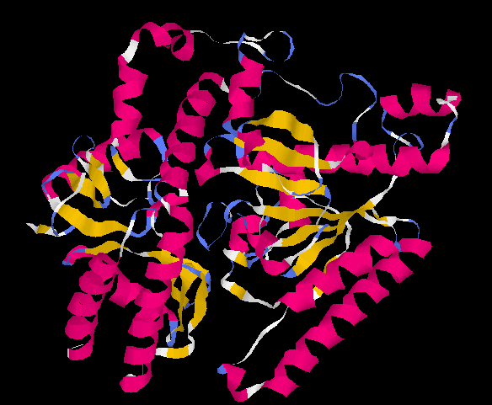
RasMol
By: Lavang Vu
https://www.researchgate.net/profile/Saima-Kalsoom-2/publication/287584895/figure/fig5/AS:519879866449920@1500960427013/Ribbon-representation-of-the-modeled-GABA-AT-protein-using-Rasmol-visualization-software.png

Slide 2
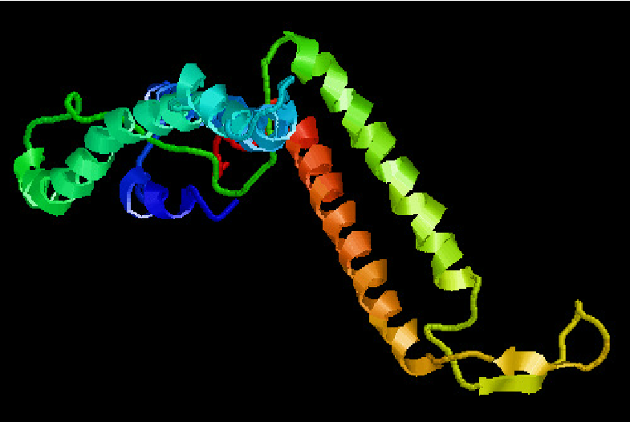
What is it?
Robert Sayle
Richard Stallman
Visualize macromolecules
Aims to provide visualizations for research
Works on Linux, UNIX, Windows, and IOS
https://www.researchgate.net/profile/Shehzad-Chaudhry/publication/252068136/figure/fig1/AS:298062409945102@1448075024948/Three-dimensional-structure-of-GJB2-protein-in-RasMol-275.png

Slide 3
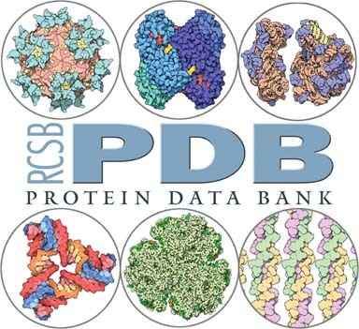
How does it do this?
PDB
Reads molecular coordinate files
https://onlinelibrary.wiley.com/cms/asset/25249ba4-6b74-4426-97a5-0c0759f60ca5/mgra001.jpg

Slide 4
Demonstration
http://rasmol.org/
6YOR

Slide 5
Pros vs. Cons
Pros
Visualize macromolecules in great detail
Can isolate amino acids or even bonds
Very good research tool
Free to use
Cons
Coding
Limited comparison capabilities
Downloaded software

Slide 6
Questions?

Slide 7
Works Cited
“Home Page for RasMol and OpenRasMol.” RasMol and OpenRasMol, rasmol.org/.
“Protein Visualization Tool | RasMol Tutorial for Beginners [PART 1].” YouTube, YouTube, 9 Dec. 2020, www.youtube.com/watch?v=cq5lpR2Hqgw.
“Protein Visualization Tool | RasMol Tutorial for Beginners [PART 2].” YouTube, YouTube, 9 Dec. 2020, www.youtube.com/watch?v=HXIkwW539jU&t=349s.

